Slide 1


A Case Study - Data Movement and Transformation using Azure Data Factory

Slide 2
Need to add Overview of session

Slide 3

Presenter
Alpa Buddhabhatti
Azure Consultant, Cluster Reply
https://www.linkedin.com/in/alpabuddhabhatti/

Slide 4
Agenda
1. Azure Data Factory (ADF)
2. DEMO – Data Movement and data transformation
3. Azure DevOps for ADF

Slide 5
Azure Data Factory (ADF)

Slide 6
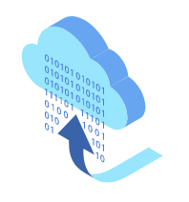
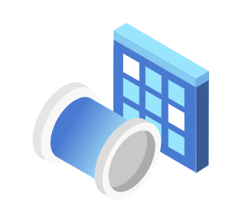
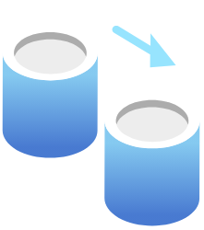
What is Azure Data Factory(ADF)?
A cloud-based data integration service that orchestrates and automates the movement and transformation of data.

Slide 7
What is Azure Data Factory(ADF)?
Azure PaaS Service
It is Serverless
Only pay for what you have use
Low-code and no-code Solutions

Slide 8
What are Key Components of ADF?
1
Linked services
2
Datasets
3
Activities
4
Pipelines
5
Triggers

Slide 9

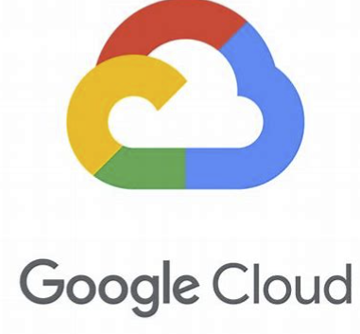
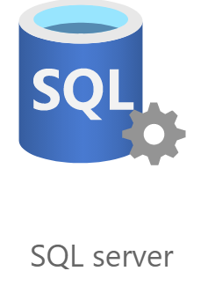
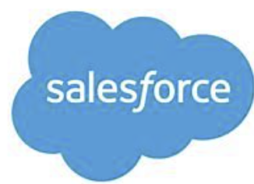

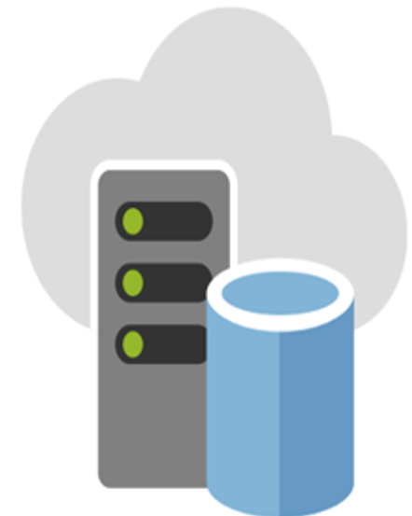




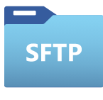
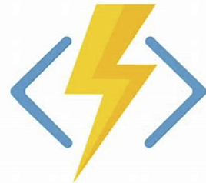
ADF – Data Movement
COPY DATA
>100
Copy activity - Azure Data Factory & Azure Synapse | Microsoft Docs

Slide 10

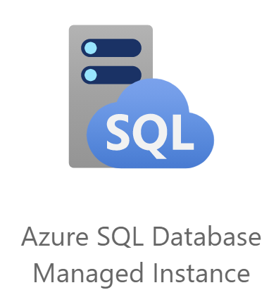
ADF – Data Transformation
TRANSFORMATION
~12
Source transformation in mapping data flow - Azure Data Factory & Azure Synapse | Microsoft Docs

Slide 11

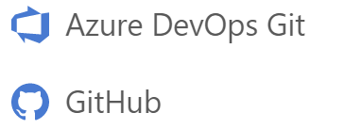


What can you do in ADF?
Pipelines are JSON, ready for Source Control
Built in Git Integration
Monitor
Manage

Slide 12
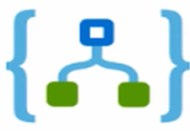

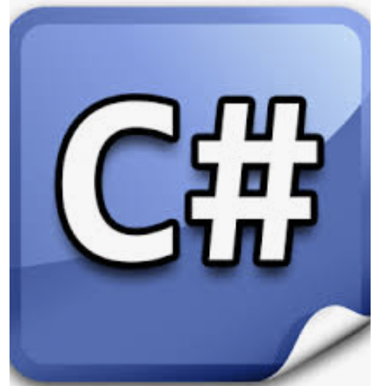
What can you do in ADF?
Trigger pipeline
A Specific Time
File created or deleted from Blob Storage
Customer Activity such as

Slide 13



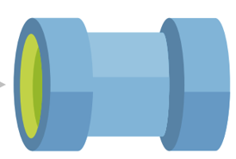
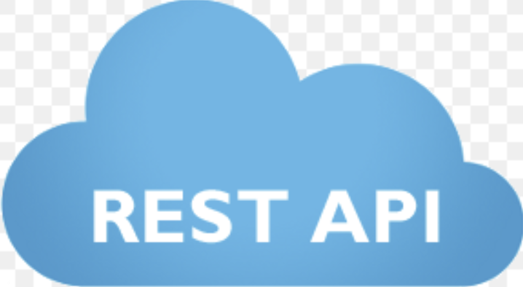

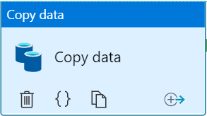


How Data Factory Works?
Let’s Imagine we have scenarios to move Data from REST API to Azure SQL SERVER
SOURCE
SINK
LINKED SERVICE – REST API
COPY ACTIVITY
AZURE SQL DATASET
LINKED SERVICE – AZURE SQL
REST API DATASET

Slide 14
DEMO
A Quick ADF Tour!!!

Slide 15
2. DEMO
Case Study

Slide 16
DEMO
Scenarios :
Moving data from Azure Blob storage to Azure Data Lake. Transforming data using Azure data flow.
Following Azure resources needed per environment
Azure Resource group
Azure Data factory
Azure Data Lake
Azure Blob Storage
Azure SQL Server
Azure Key Vault

Slide 17
DEMO
Problem Statement :
Blob Storage Gen 2
Data Lake Gen 2
Data Lake Gen 2
speccode-in
speccode-staging
speccode
bo001-in
bo001-staging
bo001
Movie data Files – bo001
bo002-in
bo002-staging
bo002
Magazines Membership data Files – bo002
bo003-in
bo003-staging
bo003
Site Membership data files – bo003

Slide 18


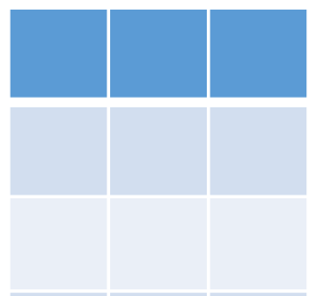
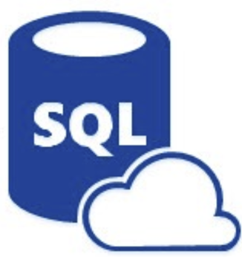
2. DEMO
1
2
3
Data Movement
Data Transformation
Blob Storage
Azure Data Lake Gen 2
Azure SQL Server

Slide 19
3. Azure DevOps for ADF

Slide 20
What is Continuous Integration/Continuous delivery(CI/CD) in ADF?
CI - Continuous Integration (Build Pipeline)
It is a practice of testing each change made to your codebase automatically and early as possible.
CD - Continuous Delivery (Release Pipeline)
Continuous delivery follows the testing happen during CI and push changes from staging to production

Slide 21
What is CI/CD lifecycle in ADF?
Moving data factory pipelines from one environment to another environment
Only Dev ADF is connected to repository
DEV ADF repository deploy to ADF-TST/ADF-SIT/ADF-PRD using release mechanism
Manually using Export/Import ARM template From ADF Portal
Automatically
Using CI/CD pipeline

Slide 22
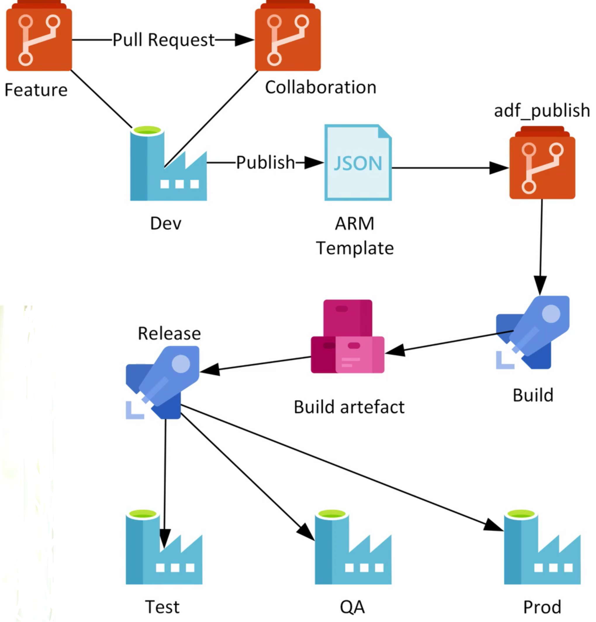
ADF CI/CD – Lifecycle
DataDevOps/ADFDevOps.md at master · davedoesdemos/DataDevOps · GitHub

Slide 23
Thank you!!!!

Slide 24
Questions !!!
Alpa Buddhabhatti
Azure Consultant, Cluster Reply https://www.linkedin.com/in/alpabuddhabhatti/

Slide 25
Resource & Materials
Dativerse2021_DEMO/AZDEV-DF-DEMO at adf_publish · alpaBuddhabhatti/Dativerse2021_DEMO (github.com)
benkettner/ADF-Demo (github.com)

